Slide 1

TOPIC: PREPARATION OF REAGENTS FOR FOOD ANALYSIS
Dr. K. MAHMOODAH PARVEEN
ASSISTANT PROFESSOR
PG & RESEARCH DEPARTMENT OF CHEMISTRY
JAMAL MOHAMED COLLEGE
TRICHY-20

Slide 2
FOOD ANALYSIS
Food analysis is the discipline dealing with the development, application and study of analytical procedures for characterizing the properties of foods and their constituents.

Slide 3
FOOD ANALYSIS
Food analysis is a very important branch of analytical chemistry, able to provide information about chemical composition, processing, quality control (QC) and contamination of foodstuffs, ensuring compliance with food and trade laws.

Slide 4
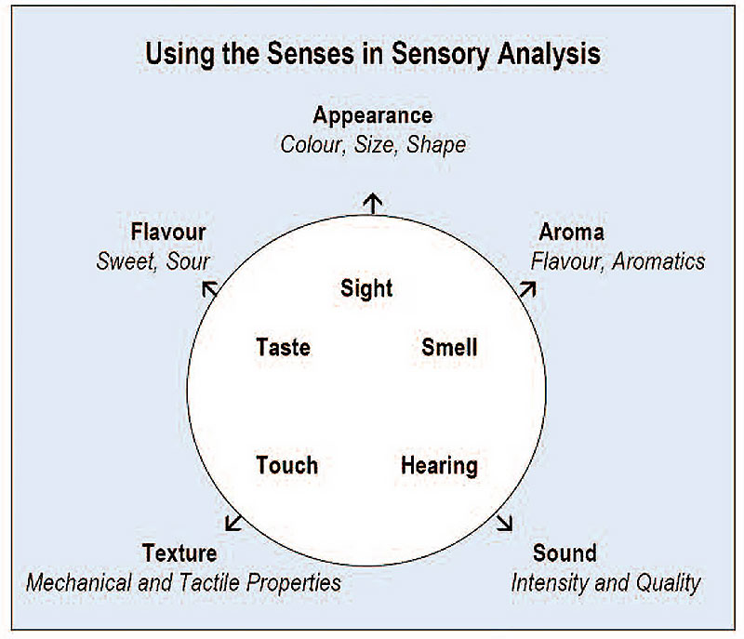

Slide 5
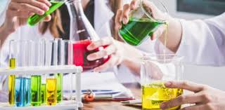
PREPARATION OF REAGENTS

Slide 6
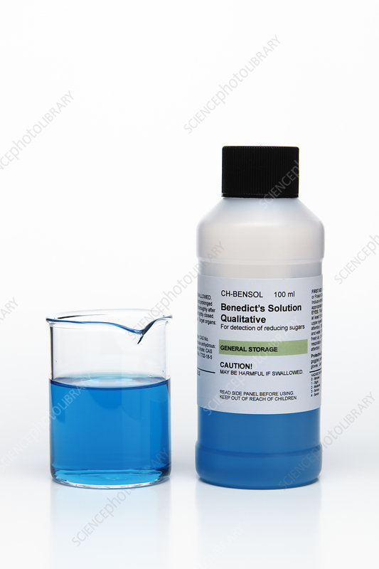
BENEDICT’S REAGENTS

Slide 7
Benedict's reagent (often called Benedict's qualitative solution or Benedict's solution) is a chemical reagent and complex mixture of sodium carbonate, sodium citrate and copper(II) sulfate pentahydrate.
It is often used in place of Fehling's solution to detect the presence of reducing sugars.

Slide 8
Preparation of Benedict's Reagent
One litre of Benedict's reagent can be prepared by mixing 17.3 grams of copper sulfate pentahydrate (CuSO₄. 5H₂O), 100 grams of sodium carbonate (Na₂CO₃), and 173 grams of sodium citrate in distilled water (required quantity).

Slide 9
Principle of Benedict's Test
When Benedict's reagent solution and reducing sugars are heated together, the solution changes its color to orange-red/ brick red precipitate. The red-colored cuprous oxide is insoluble in water and hence, separate out from the solution.

Slide 10
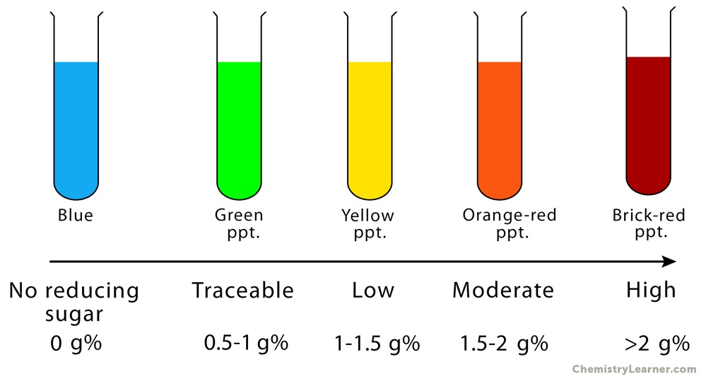

Slide 11
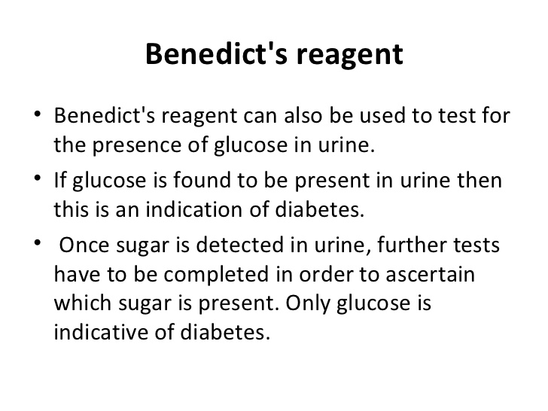

Slide 12
BIURET SOLUTION FOR PROTEIN
Biuret Reagent is an aqueous solution of potassium sodium tartrate treated with cupric sulfate and sodium hydroxide. In the presence of peptide bonds (protein), this blue solution will change color to pink-purple.

Slide 13
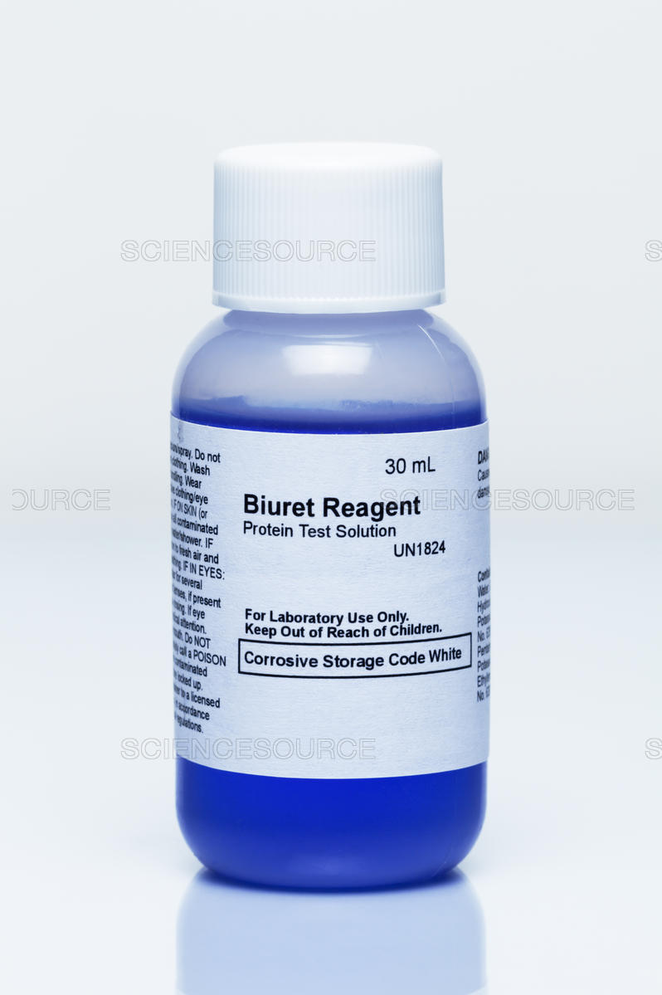

Slide 14
The biuret test, also known as Piotrowski's test, is a chemical test used for detecting the presence of peptide bonds.
The test is named so because it also gives a positive reaction to the peptide-like bonds in the biuret molecule.
The reagent used in the Biuret Test is a solution of copper sulfate (CuSO4) and sodium hydroxide (NaOH). The NaOH is there to raise the pH of the solution to alkaline levels; the crucial component is the copper II ion (Cu2+) from the CuSO4.

Slide 15
Preparation of the Biuret reagent
Dissolve 1.5g copper (II) sulphate pentahydrate and 6g sodium potassium tartrate in 500ml water.
Add 300ml 10% (w/v) NaOH and make the volume to 1 litre with water.
The Biuret reagent is made of sodium hydroxide (NaOH) and hydrated copper(II) sulfate, together with potassium sodium tartrate, the latter of which is added to chelate and thus stabilize the cupric ions.

Slide 16
PRINCIPLE OF BIURET SOLUTION
The biuret method is based on the fact that proteins (and, as a rule, all substances containing two or more peptidic bonds) react with copper to form a colored complex whose absorption (λ_{max}= 454 nm), in the presence of excess copper, is proportional to the amount of protein present.

Slide 17
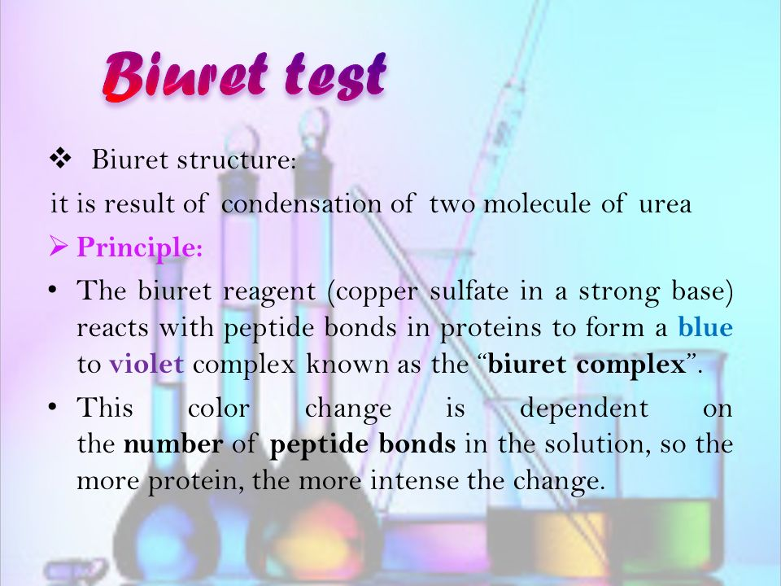

Slide 18
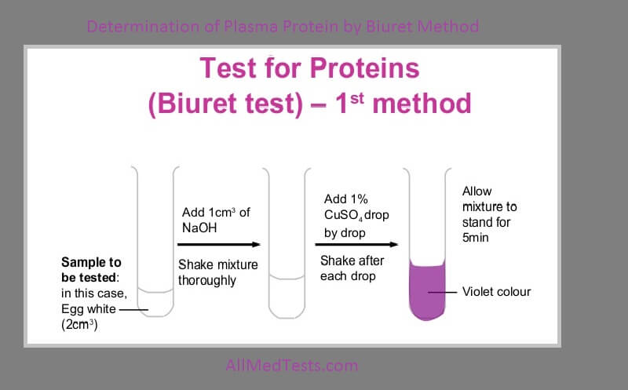

Slide 19
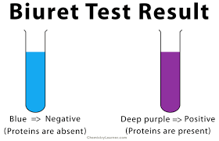

Slide 20
USES OF BIURET SOLUTION
Biuret solution is used to identify the presence of protein. Biuret reagent is a blue solution that, when it reacts with protein, will change color to pink-purple.

Slide 21
Sudan III stain for fat
Sudan III is a red fat-soluble dye that is utilized in the identification of the presence of lipids, triglycerides and lipoproteins.
This test is conducted to test for the presence of lipids in a solution. An emulsion is the formation of the solution as a lipid is dissolved in alcohol.

Slide 22
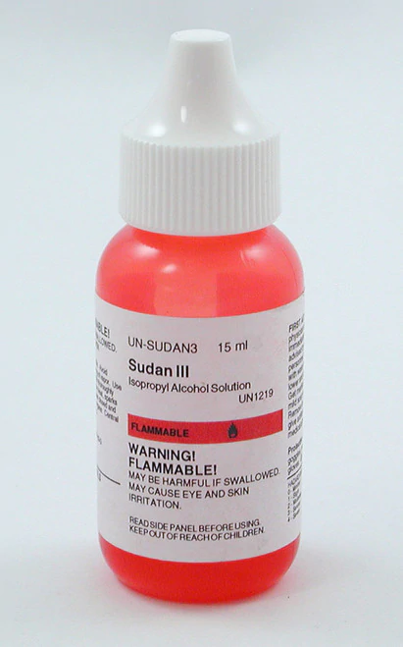

Slide 23
Preparation of Sudan III
Prepare a saturated stock solution of Sudan III in 99% isopropanol.
Dilute 6 ml of the stock solution with 4 ml of water. Incubate for 5-10 minutes and then filter the solution.

Slide 24
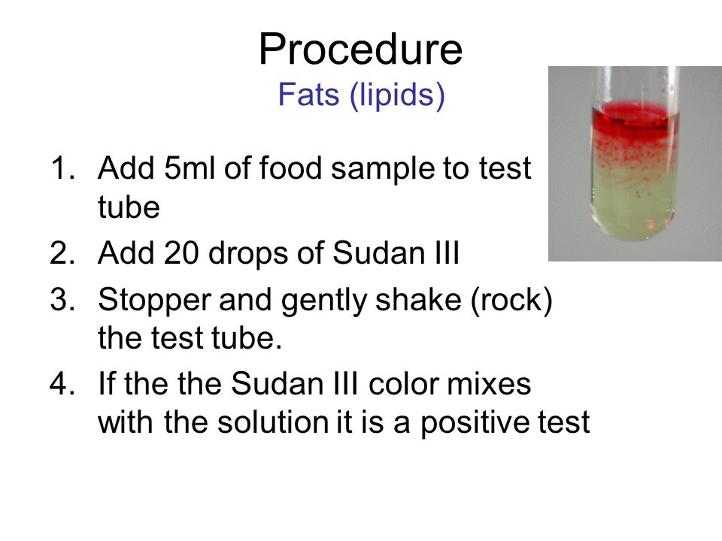

Slide 25
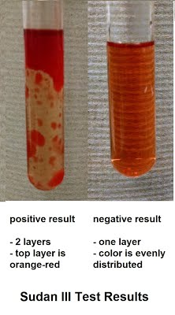

Slide 26
Uses of Sudan III
Sudan stain test is often used to determine the level of fecal fat to diagnose steatorrhea.
the Sudan III test is used to detect the hydrocarbon chains of lipids. Sudan is a red, non-polar, dye that forms hydrophobic interactions with the hydrocarbon chains of lipids.

Slide 27
THANK YOU !

